Slide 1

Assam & Tamil Nadu Comparison together
Presented by:
Simranjeet Kaur

Slide 2
A quick brief about the concepts/tools I used for this analysis:
Started the analysis by finding the appropriate data.
Data source: https://trai.gov.in/sites/default/files/PIR_08012020_0.pdf
Extracted data from pdf tables using python tabula library, performed data cleaning, converted into dataframe and saved it in excel format.
Performed analysis in form of visualizations in excel.

Slide 3
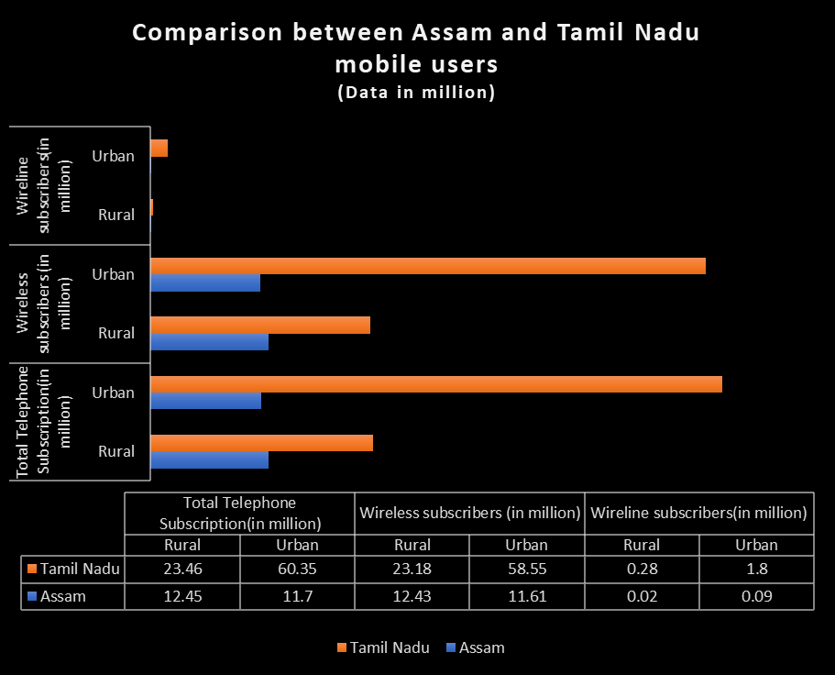
Self-explanatory data

Slide 4
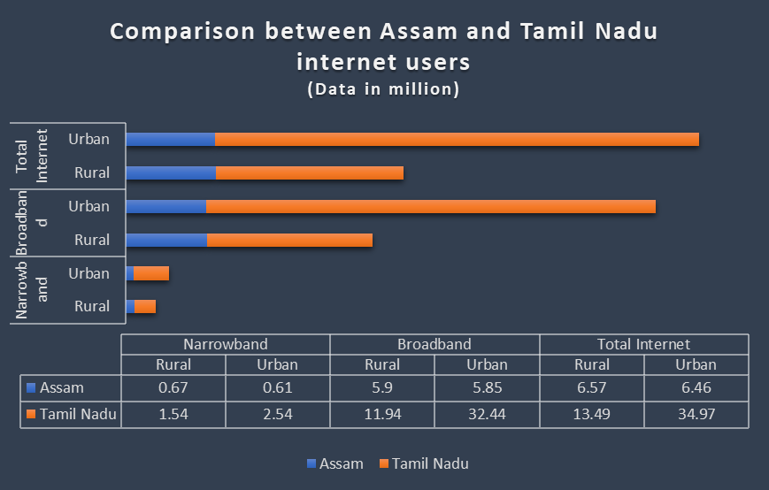

Slide 5
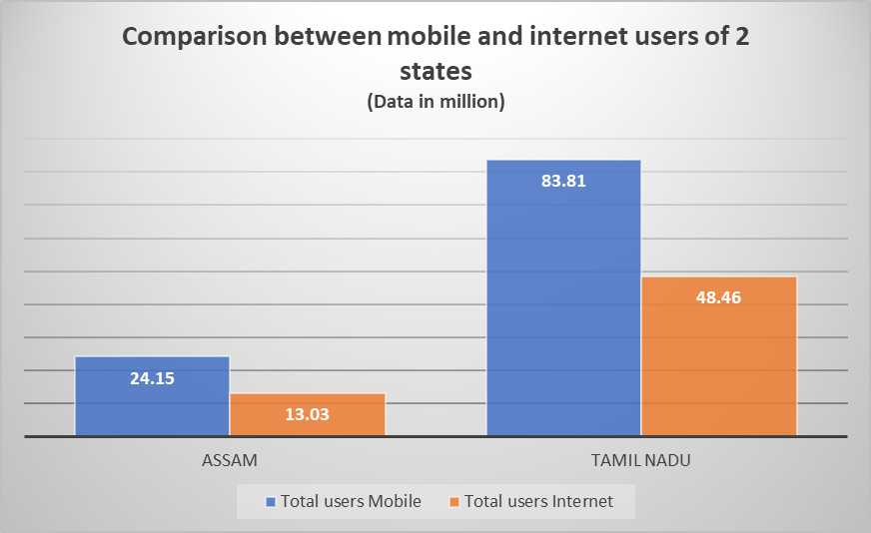
Findings:
-Not all people who are having mobile have internet connection.
-As per the graph, it is understood that Tamil Nadu’s population is far more than Assam’s population.

Slide 6
Thanks for considering!

